Slide 1

Variables, Data Types, and Operators in C# and Important classes in Unity

Slide 2
Learning Objectives
Understand the role of variables in C#.
Learn about different data types and their usage.
Gain proficiency in using operators for various operations.
Learn about important classes of Unity

Slide 3
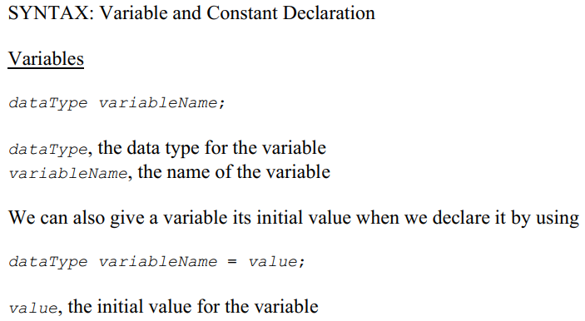
Variables in C#
To store something (such as a name, the value of Pi, or a GameObject) in our program, we need to declare a variable or a constant.
Image source: Unity.com

Slide 4
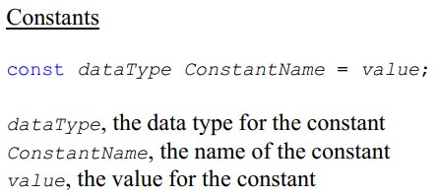
Variables in C#
For variable names, we use something called Camel case, eg. variableName.
For constant names, we use something called Pascal case, eg. ConstantName.
Image source: Unity.com

Slide 5
Data types in C#
Data in C# fall into two categories: value types and reference types.
A variable of a value type contains an instance of the type.
On assignment, the corresponding type instances are copied.
A variable of a reference type contains a reference to an instance of the type.
On assignment, only the reference to the instance of the reference type is copied.
Image source: Unity.com

Slide 6
Data types in C#
Value types are the most basic data types there are in C#, and their values are stored directly into memory locations.
For a variable, the contents of the location are called the value of the variable – and we can change what's in that location as many times as we want as the program executes.
For a constant, the memory location contains whatever we said the constant's value would be, and we're never allowed to change it as the program executes.
Image source: Unity.com

Slide 7

Data types in C#
The data type for a variable or constant tells us two things:
What values the variable or constant can have, and
What operations are valid for the variable or constant
Example:
tells us that the only values this variable can have are floating point numbers and also know which operations (+, -, *, / etc.) are valid for this variable
Image source: Unity.com

Slide 8

Data types in C#
We might use an integer variable to
Count things
Store the number of points a student gets on a test
Keep track of the current pixel location of a game object
Indicate the amount of damage a particular weapon inflicts
etc.
Example declarations:
Image source: Unity.com

Slide 9
Data types in C#
The valid operations for integers: +, -, *, /, %, ++, --
Four different data types: byte, short, int, and long
What is size of each integer type?
What are minimum and maximum value of them?
Why do people care about these?
Image source: Unity.com

Slide 10
Data types in C#
How to store and process numbers that have a decimal part as well as a whole number part, e.g. -3.7, 0.00001, 5.0, and 483.256?
Two different data types for floating point numbers: float and double
A float variable or constant gets 32 bits of memory, and a double variable or constant gets 64 bits.
Unity tends to favor float over double.
The valid operations for floating point: +, -, *, and /
How to store a floating point?
Mantissa and exponent
Image source: Unity.com

Slide 11
Data types in C#
The floating point data types could not handle all our real number needs.
Because everything in a computer is stored using a limited number of bits, the computer works in the discrete domain.
Let's talk about the double data type
A double is stored in 64 bits, so the total number of unique values that we can store in a double is 2^64, which is about 1.8 * 10^19 ➔ it's not infinite.
That means that we have to approximate lots of those infinite numbers in the real world with a single sequence of bits in the computer, making them indistinguishable from each other.
We can't get perfect precision with our floating point data types.
Image source: Unity.com

Slide 12
Data types in C#
Think about a program that runs a cash register. That program needs to be able to precisely store dollars and cents.
Allowing imprecision in the variables we use won't be acceptable.
The decimal type helps solve that problem.
The 128 bits used for the decimal type can more precisely represent the possible values in its range
range from -79,228,162,514,264,337,593,543,950,335 to 79,228,162,514,264,337,593,543,950,335.
stores up to 28 decimal places.
Image source: Unity.com

Slide 13

Data types in C#
Example:
The valid operations for decimal: +, -, *, and /
The tradeoff we make between decimal and the floating point types is that decimal gives us more precise numbers in a smaller range.
the best choice for some domains, like cash register software, but
a worse choice for other domains, like quantum physics
By considering what range of numbers your program needs to store and with what precision, you can make a reasoned choice about which data type to use.
Image source: Unity.com

Slide 14

Data types in C#
A variable or constant declared as a char (short for character) can hold a single 16-bit Unicode character.
A character can be a letter, a digit, a space, a punctuation mark, or other characters.
Example:
Image source: Unity.com

Slide 15
Data types in C#
A variable or constant declared as a char (short for character) can hold a single 16-bit Unicode character.
A character can be a letter, a digit, a space, a punctuation mark, or other characters.
Example:
Image source: Unity.com

Slide 16
Unity-Specific Data Types
Unity provides specialized data types for game development.
Understanding these types is crucial for effective scripting.
Some of the key Unity-specific data types:
Vectors: Vector2, Vector3, Vector4
Quaternion
GameObject
MonoBehaviour
Transform
Color
Material
Rigidbody
Collider
Image source: Unity.com

Slide 17
Game Object
Unity’s GameObject class represents anything which can exist in a Scene.
Base class for all entities in Unity Scenes.
GameObjects are the building blocks for scenes in Unity, and act as a container for functional components which determine how the GameObject looks, and what the GameObject does.
In scripting, the GameObject class provides a collection of methods which allow you to work with them in your code, including finding, making connections and sending messages between GameObjects, and adding or removing components attached to the GameObject, and setting values relating to their status within the scene.
Properties and methods: Refer to https://docs.unity3d.com/ScriptReference/GameObject.html
Image source: Unity.com

Slide 18
MonoBehaviour
MonoBehaviour is a base class that many Unity scripts derive from.
MonoBehaviour offers life cycle functions that make it easier to develop with Unity.
MonoBehaviours always exist as a Component of a GameObject, and can be instantiated with GameObject.AddComponent. Objects that need to exist independently of a GameObject should derive from ScriptableObject instead.
A MonoBehaviour can be deleted with Object.Destroy or Object.DestroyImmediate. When the parent GameObject is destroyed all components are automatically deleted, including MonoBehaviours.
After the underlying component is destroyed, the C# object for the MonoBehaviour remains in memory until garbage is collected. A MonoBehaviour in this state acts as if it is null. For example, it returns true for a "obj == null" check. However, this class doesn't support the null-conditional operator (?.) and the null-coalescing operator (??).
Image source: Unity.com

Slide 19
MonoBehaviour
When a MonoBehaviour is serialized, the value of C# fields are included according to Unity's Serialization rules. See Script Serialization for details. The serialized data also includes internal properties, such as the reference to the MonoScript that tracks the implementation class for the object.
Properties and methods: Refer to https://docs.unity3d.com/ScriptReference/MonoBehaviour.html
Image source: Unity.com

Slide 20
MonoBehaviour
When a MonoBehaviour is serialized, the value of C# fields are included according to Unity's Serialization rules. See Script Serialization for details. The serialized data also includes internal properties, such as the reference to the MonoScript that tracks the implementation class for the object.
Properties and methods: Refer to https://docs.unity3d.com/ScriptReference/MonoBehaviour.html
Image source: Unity.com

Slide 21
MonoBehaviour
When you create a script in the Editor, Unity automatically provides a template script which inherits from the MonoBehaviour class. Inheriting from the MonoBehaviour class means your script can behave like a type of component, and you can attach it to GameObjects like any other component.
When your script inherits from MonoBehaviour, you can include properties and values in your script which you can then edit from the Editor Inspector, like you can with any other component.
Image source: Unity.com

Slide 22
MonoBehaviour
The example code below declares a public variable called myName. When you place this script on a GameObject in your scene, the variable becomes visible in the Inspector as a field labelled “My Name”. The default value of “none” declared in the script becomes the default value in the field in the Inspector, which you can then change by typing into the field.
Image source: Unity.com

Slide 23
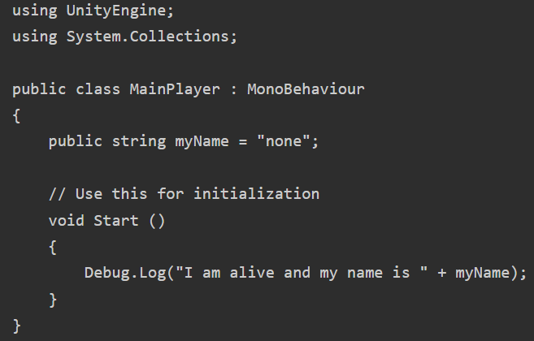
MonoBehaviour
Image source: Unity.com

Slide 24
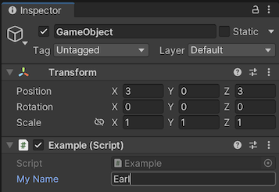
MonoBehaviour
Each GameObject that you place your script component on can have its own unique value for the field.
A public string field editable in the inspector window.
Image source: Unity.com

Slide 25
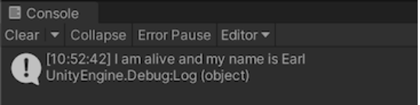
MonoBehaviour
To create the Inspector label, Unity inserts a space between lowercase and uppercase characters in the variable name, and applies several other rules (see the slide of Variable name to label conversion). However, these changes are purely for display purposes. You should always use the variable name within your code.
In the Inspector, if you edit the My Name value and press Play, the console message should now include the text that you entered.
Image source: Unity.com

Slide 26
MonoBehaviour
In C#, the simplest way to make a variable editable in the Inspector is to declare it as public. If you want to make a private field editable in the inspector, you can use the SerializeField attribute. Conversely, you can use the [HideInInspector] attribute to prevent a public variable from being displayed in the Inspector.
Note: You can change the value of a script’s variables in the Editor while running in play mode. This is very useful for seeing the effects of changes directly without having to stop and restart. However, when you stop play mode, the values of the variables reset to whatever they were before you entered play mode (as is the case for all scripts and components).
Image source: Unity.com

Slide 27
Variable name to label conversion
The Inspector applies several rules when it converts your variable name to a label in the Inspector. For example, the variable names in the examples above have been converted from myName to “My Name”, and from objectToFollow to “Object To Follow”. The rules are as follows:
Capitalize the first letter
Add a space between lowercase and uppercase characters
Add a space between an acronym and an uppercase character at the beginning of the next word
Remove “m_” from the beginning
Remove “k” from the beginning
Remove “_” from the beginning
There are some special cases, such as “iPad” or “x64”, where these rules are not applied.
Image source: Unity.com

Slide 28
Vectors
Vectors are a fundamental mathematical concept used in games and apps to represent direction and magnitude.
In programming, especially in graphics, physics, and animation, vector arithmetic is crucial.
Unity provides Vector2, Vector3, and Vector4 classes for working with 2D, 3D, and 4D vectors. These classes share many functions like magnitude.
Understanding vectors is essential for maximizing Unity's capabilities.
Image source: Unity.com
Notes:
Vectors are a fundamental mathematical concept which allow you to describe a direction and magnitude. In games and apps, vectors are often used to describe some of the fundamental properties such as the position of a character, the speed something is moving, or the distance between two objects.
Vector arithmetic is fundamental to many aspects of computer programming such as graphics, physics and animation, and it is useful to understand it in depth to get the most out of Unity.
Vectors can be expressed in multiple dimensions, and Unity provides the Vector2, Vector3 and Vector4 classes for working with 2D, 3D, and 4D vectors. These three types of Vector classes all share many of the same functions, such as magnitude, so most of the information on this page applies to all three types of Vector unless otherwise specified.
This page provides an overview of the Vector classes and their common uses when scripting with them. For an exhaustive reference of every member of the vector classes, see the script reference pages for Vector2, Vector3 and Vector4.

Slide 29
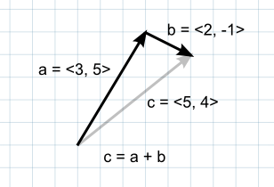
Understanding Vector Arithmetic
Addition: When two vectors are added together, the result is equivalent to taking the original vectors as “steps”, one after the other. Note that the order of the two parameters doesn’t matter, since the result is the same either way.
Image source: Unity.com

Slide 30
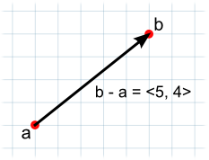
Understanding Vector Arithmetic
Subtraction: Vector subtraction is most often used to get the direction and distance from one object to another. Note that the order of the two parameters does matter with subtraction
Image source: Unity.com

Slide 31
Understanding Vector Arithmetic
Direction and Distance from One Object to Another: If one point in space is subtracted from another, then the result is a vector that “points” from one object to the other:
As well as pointing in the direction of the target object, this vector’s magnitude is equal to the distance between the two positions. You may need a “normalized” vector giving the direction to the target, but with a fixed distance (say for directing a projectile). You can normalize a vector by dividing it by its own magnitude:
Image source: Unity.com

Slide 32
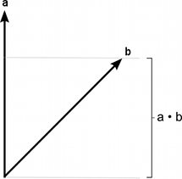
Understanding Vector Arithmetic
Dot Product: The dot product takes two vectors and returns a scalar. This scalar is equal to the magnitudes of the two vectors multiplied together and the result multiplied by the cosine of the angle between the vectors. When both vectors are normalized, the cosine essentially states how far the first vector extends in the second’s direction (or vice-versa - the order of the parameters doesn’t matter).
The dot product is useful if you want to calculate the amount of one vector’s magnitude that lies in the direction of another vector.
Image source: Unity.com

Slide 33
Understanding Vector Arithmetic
Dot Product:
For example, a car’s speedometer typically works by measuring the rotational speed of the wheels. The car may not be moving directly forward (it may be skidding sideways, for example) in which case part of the motion will not be in the direction the car is facing - and so won’t be measured by the speedometer. The magnitude of an object’s rigidbody.velocity vector will give the speed in its direction of overall motion but to isolate the speed in the forward direction, you should use the dot product:
Image source: Unity.com

Slide 34
Understanding Vector Arithmetic
Cross Product: The cross product is only meaningful for 3D vectors. It takes two 3D vectors as input and returns another 3D vector as its result.
The result vector is perpendicular to the two input vectors. You can use the “right hand screw rule” to remember the direction of the output vector from the ordering of the input vectors. If you can curl your fingers in the order of the input vectors, your thumb points in the direction of the output vector. If the order of the parameters is reversed then the resulting vector will point in the exact opposite direction but will have the same magnitude.
The magnitude of the result is equal to the magnitudes of the input vectors multiplied together and then that value multiplied by the sine of the angle between them.
Image source: Unity.com

Slide 35
Understanding Vector Arithmetic
Computing a Normal/Perpendicular vector: A “normal” vector (ie. a vector perpendicular to a plane) is required frequently during mesh generation and is also useful in path following and other situations. Given three points in the plane, say the corner points of a mesh triangle, you can find the normal as follows:
- Pick one of the three points
- Subtract it from each of the two other points separately (resulting in two new vectors, “Side 1” and “Side 2”).
- Calculate the cross product of the vectors “Side 1” and “Side 2”.
- The result of the cross product is a new vector that is perpendicular to the plane the three original points lie on - the “normal”.
Image source: Unity.com

Slide 36
Understanding Vector Arithmetic
Computing a Normal/Perpendicular vector: A “normal” vector (ie. a vector perpendicular to a plane) is required frequently during mesh generation and is also useful in path following and other situations. Given three points in the plane, say the corner points of a mesh triangle, you can find the normal as follows:
- Pick one of the three points
- Subtract it from each of the two other points separately (resulting in two new vectors, “Side 1” and “Side 2”).
- Calculate the cross product of the vectors “Side 1” and “Side 2”.The result of the cross product is a new vector that is perpendicular to the plane the three original points lie on - the “normal”.
Image source: Unity.com

Slide 37
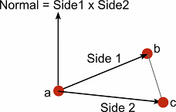
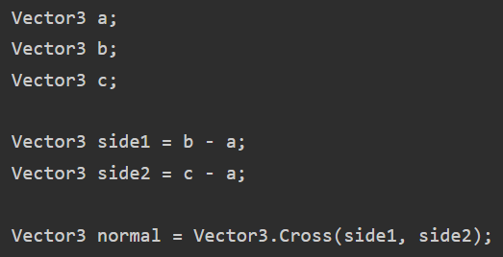
Understanding Vector Arithmetic
Computing a Normal/Perpendicular vector:
Image source: Unity.com

Slide 38
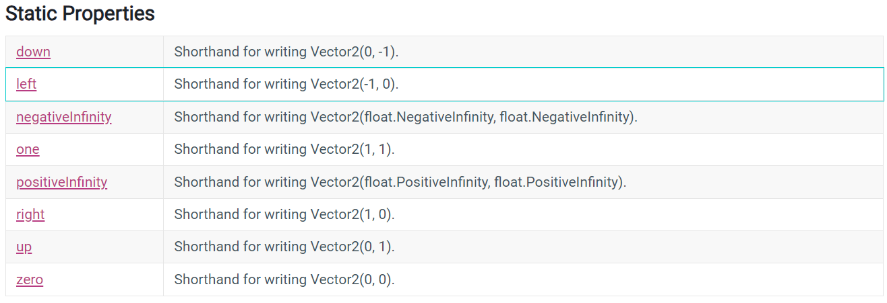
Vector2
Representation of 2D vectors and points. This structure is used in some places to represent 2D positions and vectors (e.g. texture coordinates in a Mesh or texture offsets in Material).
Image source: Unity.com

Slide 39
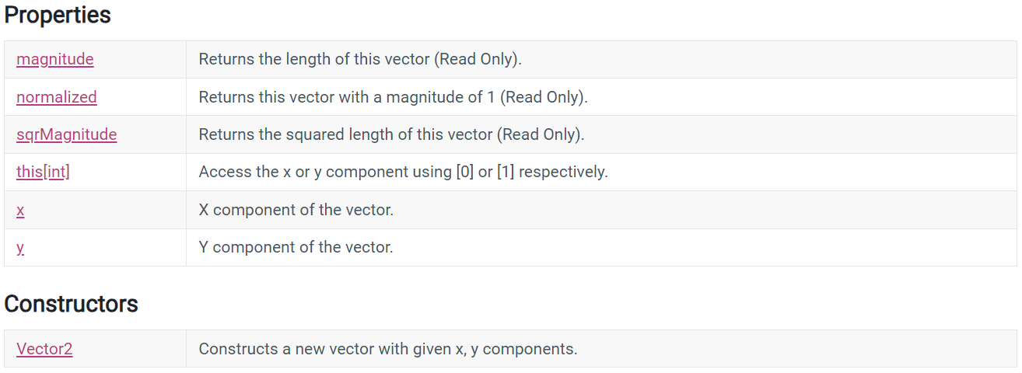
Vector2
Methods: refer to https://docs.unity3d.com/ScriptReference/Vector2.html
Image source: Unity.com

Slide 40
Quaternion
Quaternions are used to represent rotations.
They are compact, don't suffer from gimbal lock and can easily be interpolated. Unity internally uses Quaternions to represent all rotations.
They are based on complex numbers and are not easy to understand intuitively. You almost never access or modify individual Quaternion components (x,y,z,w); most often you would just take existing rotations (e.g. from the Transform) and use them to construct new rotations (e.g. to smoothly interpolate between two rotations). The Quaternion functions that you use 99% of the time are: Quaternion.LookRotation, Quaternion.Angle, Quaternion.Euler, Quaternion.Slerp, Quaternion.FromToRotation, and Quaternion.identity. (The other functions are only for exotic uses.)
Refer to https://docs.unity3d.com/ScriptReference/Quaternion.html
Image source: Unity.com

Slide 41
Transform
Position, rotation and scale of an object.
Every object in a Scene has a Transform. It's used to store and manipulate the position, rotation and scale of the object. Every Transform can have a parent, which allows you to apply position, rotation and scale hierarchically. This is the hierarchy seen in the Hierarchy pane.
Properties and Methods: Refer to https://docs.unity3d.com/ScriptReference/Transform.html
Note: A GameObject always has a Transform component attached: you can’t remove a Transform or create a GameObject without a Transform component.
Image source: Unity.com

Slide 42
Other important classes
ScriptableObject: A data container that you can use to save large amounts of data. Refer to https://docs.unity3d.com/ScriptReference/ScriptableObject.html
Time (and framerate management): The Time class allows you to measure and control time, and manage the framerate of your project. Refer to https://docs.unity3d.com/ScriptReference/Time.html
Mathf: A collection of common math functions, including trigonometric, logarithmic, and other functions commonly required in games and app development. Refer to https://docs.unity3d.com/Manual/class-Mathf.html
Random: Provides you with easy ways of generating various commonly required types of random values. Refer to https://docs.unity3d.com/ScriptReference/Random.html
Image source: Unity.com

Slide 43
Other important classes
Debug: Allows you to visualise information in the Editor that may help you understand or investigate what is going on in your project while it is running. Refer to https://docs.unity3d.com/Manual/class-Debug.html
Gizmos and Handles: allows you to draw lines and shapes in the Scene view
and Game view, as well as interactive handles and controls. Refer to https://docs.unity3d.com/ScriptReference/Gizmos.html and https://docs.unity3d.com/ScriptReference/Handles.html
Image source: Unity.com

